Slide 1
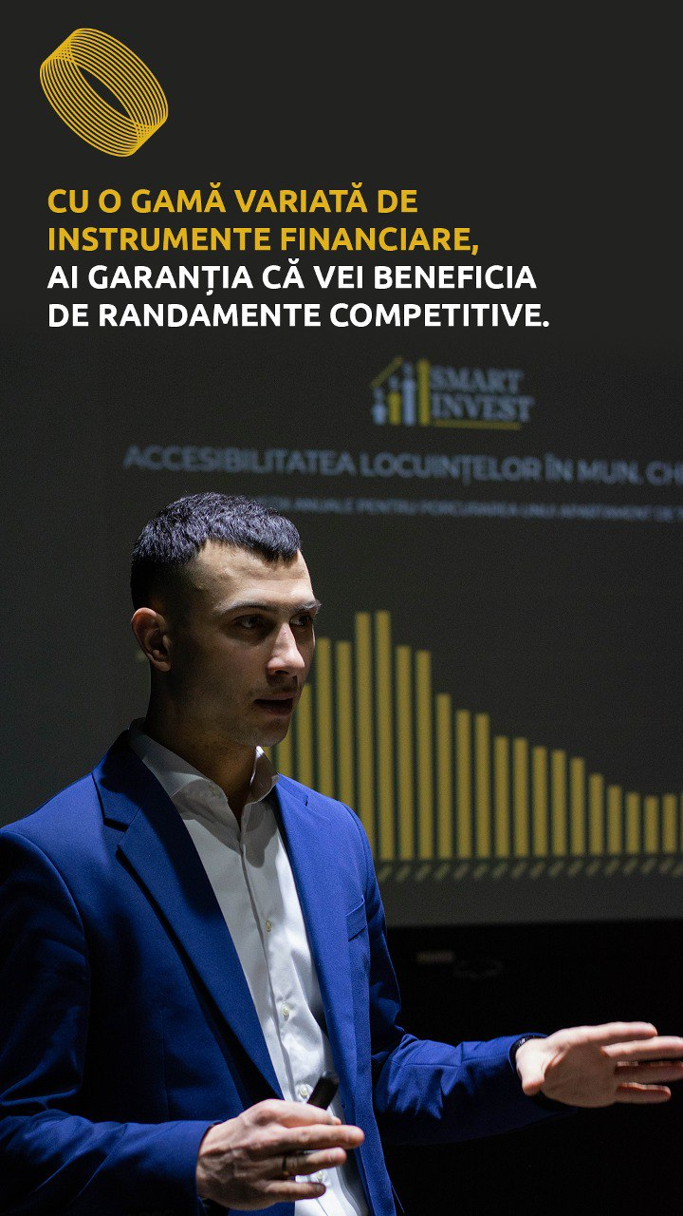
SmartInvest.md
We Invest Smart. We Build Trust.
Pitch Deck for Strategic Investors
📍 Chișinău, Republic of Moldova
🏢 7 Nicolae Zelinschi Street, Floor 5, Office 507
👤 Ilovan Dorin – Founder & Lead Consultant
📅 May 2025

Slide 2
Vision & Mission of SmartInvest.md
Our Vision
To become the #1 trusted platform for smart real estate investments in Moldova, connecting private capital with the most profitable and sustainable opportunities in the market.
Our Mission
We offer investors secure, transparent, and efficient solutions to grow their capital through high-yield real estate projects. We manage the entire process — from property sourcing to delivering profit.
Why We Do It
We believe that real estate investments can be accessible, well-managed, and profitable for both investors and developers. We focus on trust-based relationships, transparency, and real results.

Slide 3
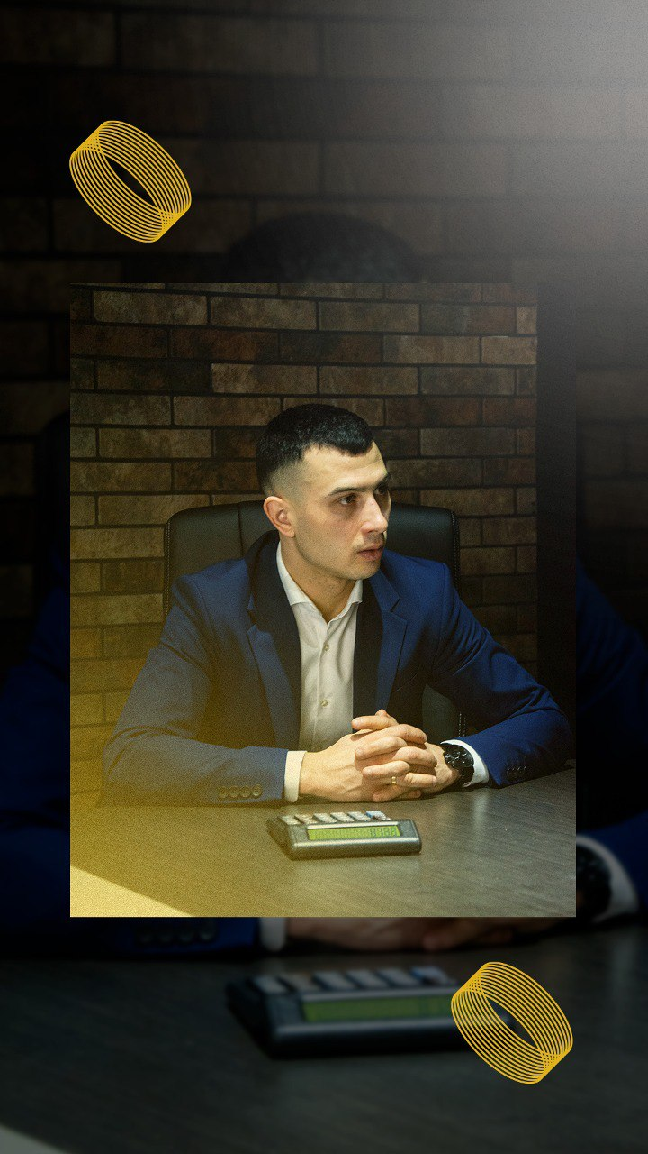
About the Founder: Ilovan Dorin
Ilovan Dorin
Founder & Lead Consultant, SmartInvest.md
“I believe in well-thought-out real estate investments and partnerships built on trust. What sets me apart is a personalized, accountable, and results-driven approach. I don’t take decisions randomly, and I don’t avoid risk — I manage it wisely.”
📌 Over 4 years of experience in real estate investments
📌 50+ successfully completed projects
📌 0 failures. 0 unhappy investors.
📌 Collaborations with both local and international investors

Slide 4
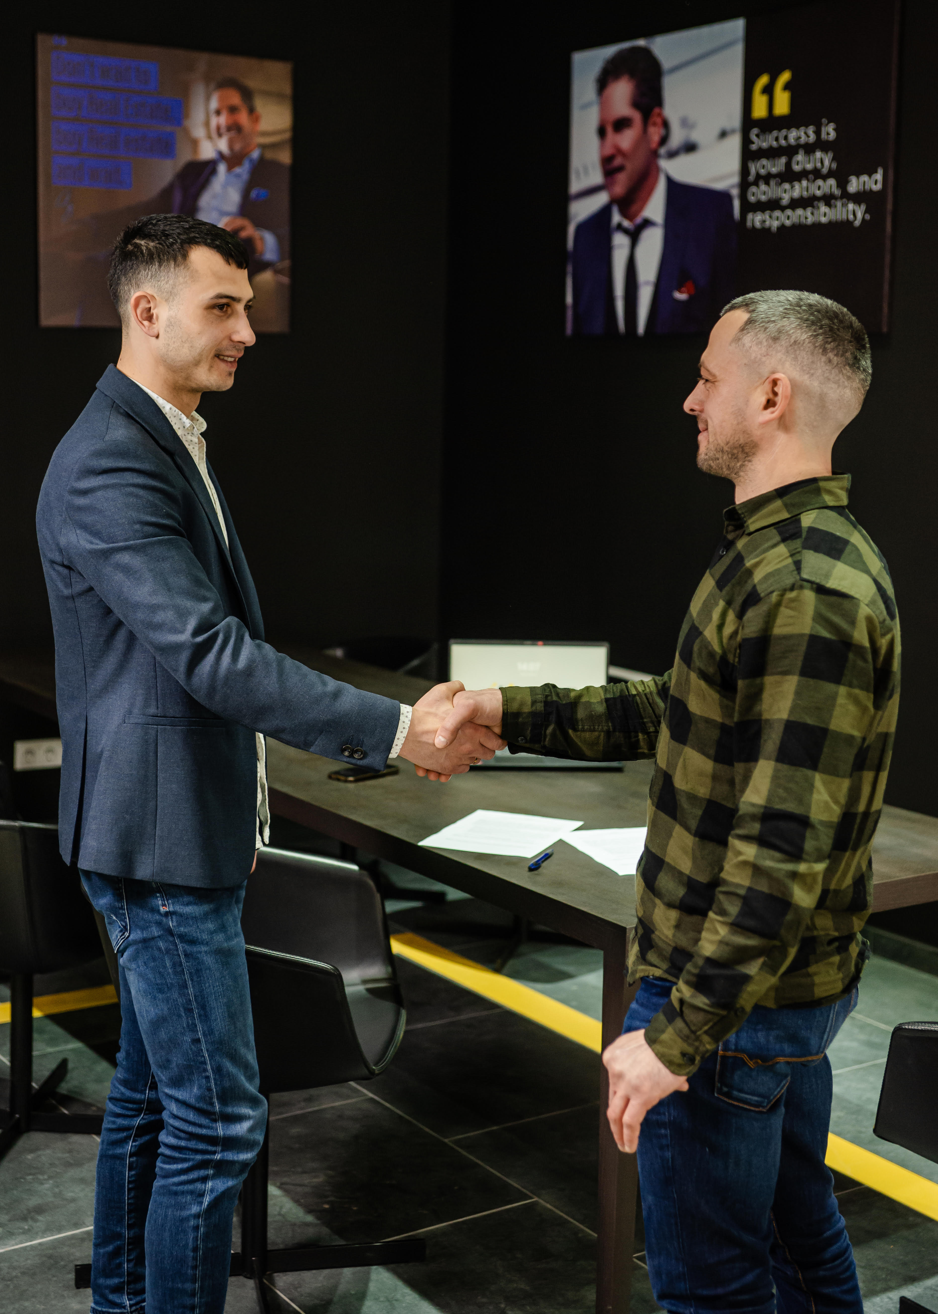
SmartInvest.md – Trust Built on Clear Numbers
📌 7 active investors, both local and international
📌 €1,500,000 currently under management
📌 Steady growth of invested capital over the past 4 years
📌 Diversified portfolios and tailored investment strategies
"Our results are not promises — they are proven facts.
SmartInvest.md grows alongside every single investor."

Slide 5
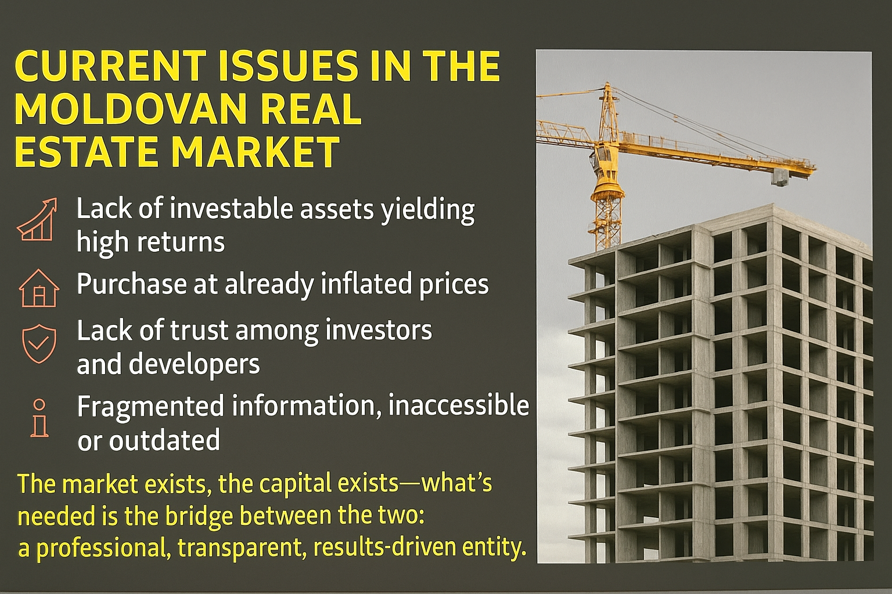

Slide 6
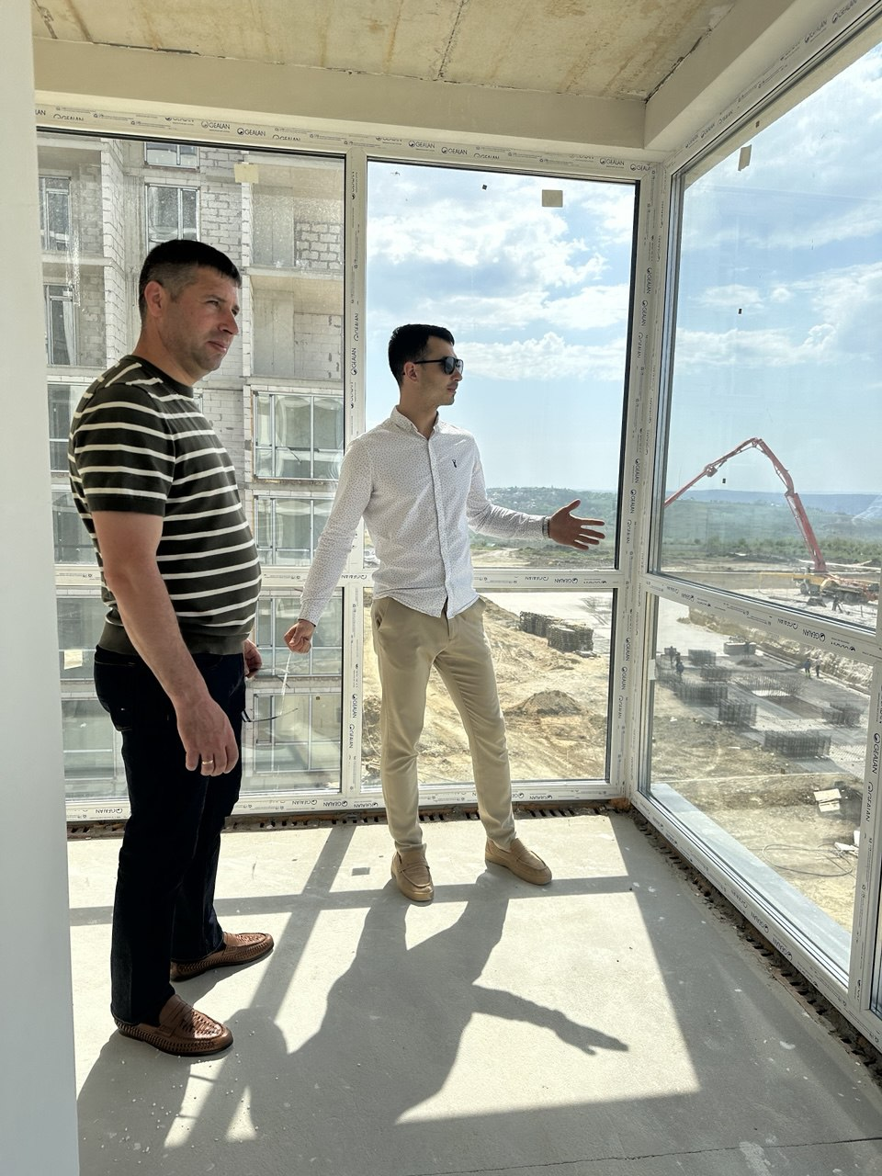
SmartInvest.md
An Integrated Solution for Successful Real Estate Investment
✅ We identify undervalued properties with high return potential
✅ We conduct complete financial analysis and estimate ROI
✅ We prepare the investment file with risks and mitigation strategies
✅ We manage the entire process: acquisition, renovation, administration
✅ We ensure full transparency and consistent reporting to the investor
✅ We offer personalised strategies for each investor profile
SmartInvest.md means more than just intermediation — we are your strategic partner every step of the way.

Slide 7
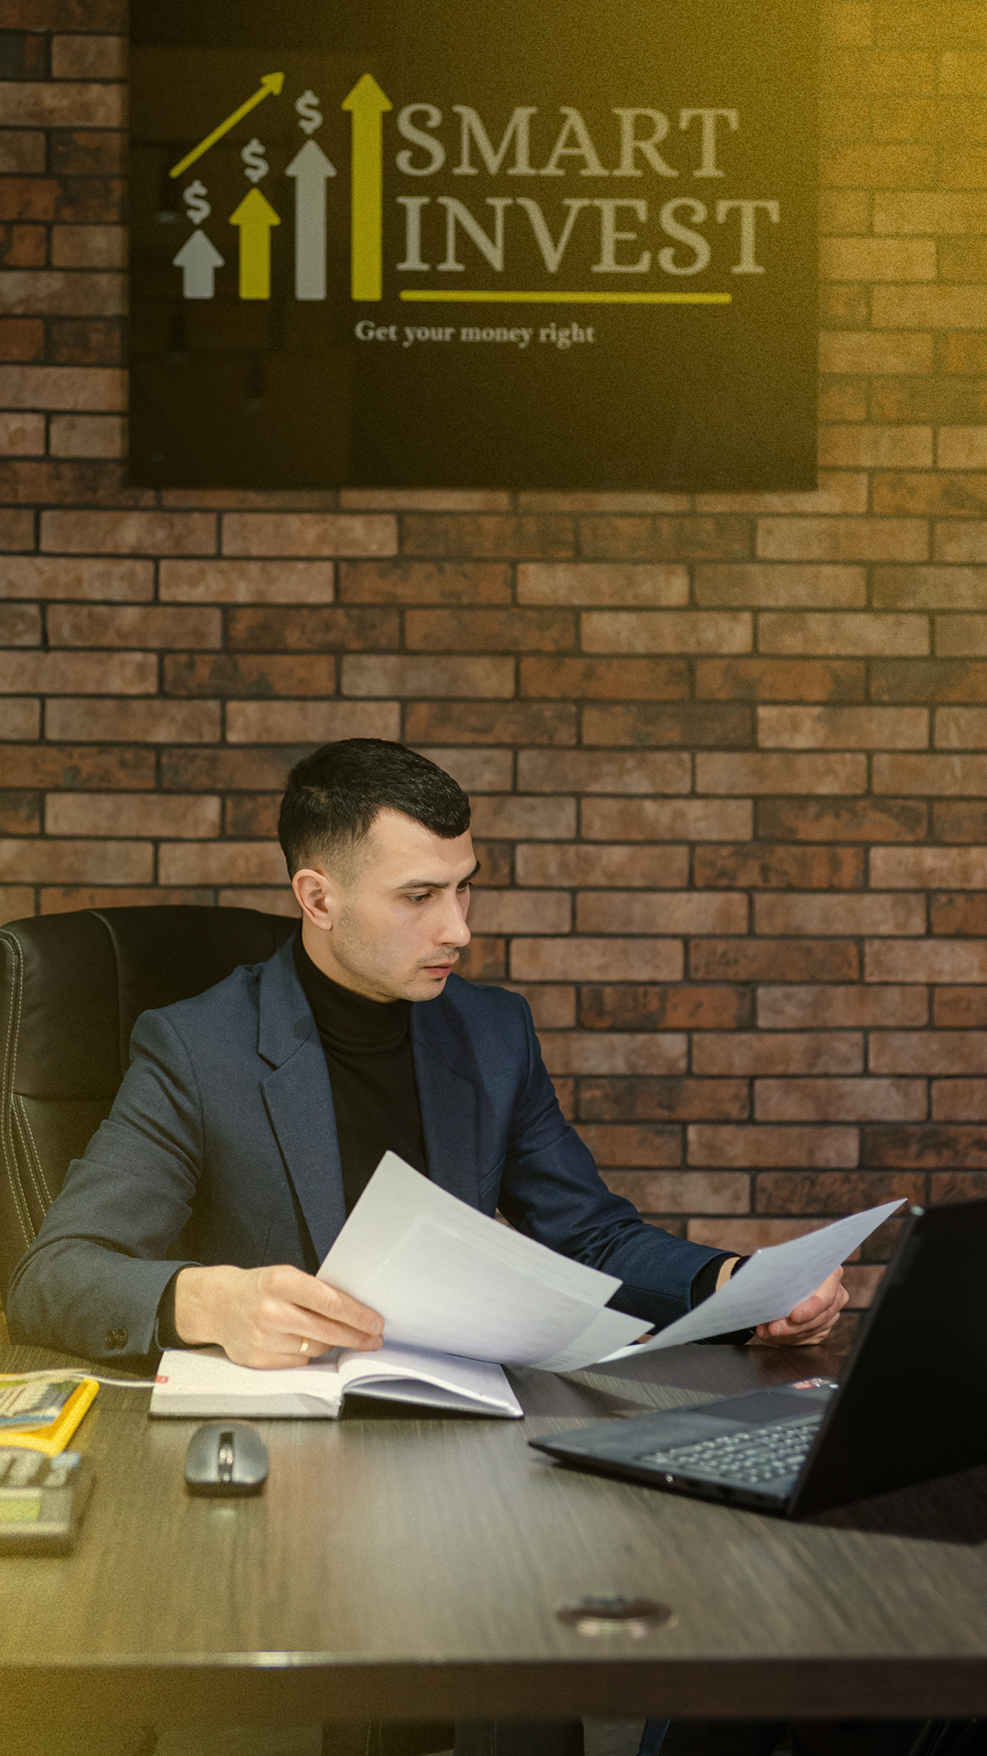
🔹 Our Business Model – Clear, Efficient, and Profitable
1. Initial contact with the investor – general overview and information exchange
2. One-on-one meeting – we assess the budget, investment period, and target profit margin
3. Deal sourcing & delivery – only strategically filtered, below-market opportunities presented in a detailed PDF with ROI projections
4. Property acquisition – directly under the investor’s name (full ownership guarantee)
5. SmartInvest takes over – we increase property value through renovation & tailored strategy
6. Sale of the property – we identify the buyer and close the transaction
7. Profit sharing – 70% to the investor / 30% to SmartInvest
Each step is fully documented, transparent, and optimised through our trusted local network of banks, suppliers, renovation teams and designers.

Slide 8

5 Reasons to Invest in Real Estate with SmartInvest.md
✔ Strong relationships with top banks in Moldova
✔ Access to skilled renovation teams – at below-market costs
✔ Significant discounts on construction materials thanks to high volume and long-term supplier partnerships
✔ Access to the best real estate opportunities on the market
✔ Local expertise and rigorous deal filtering — you only get what’s truly worth it

Slide 9
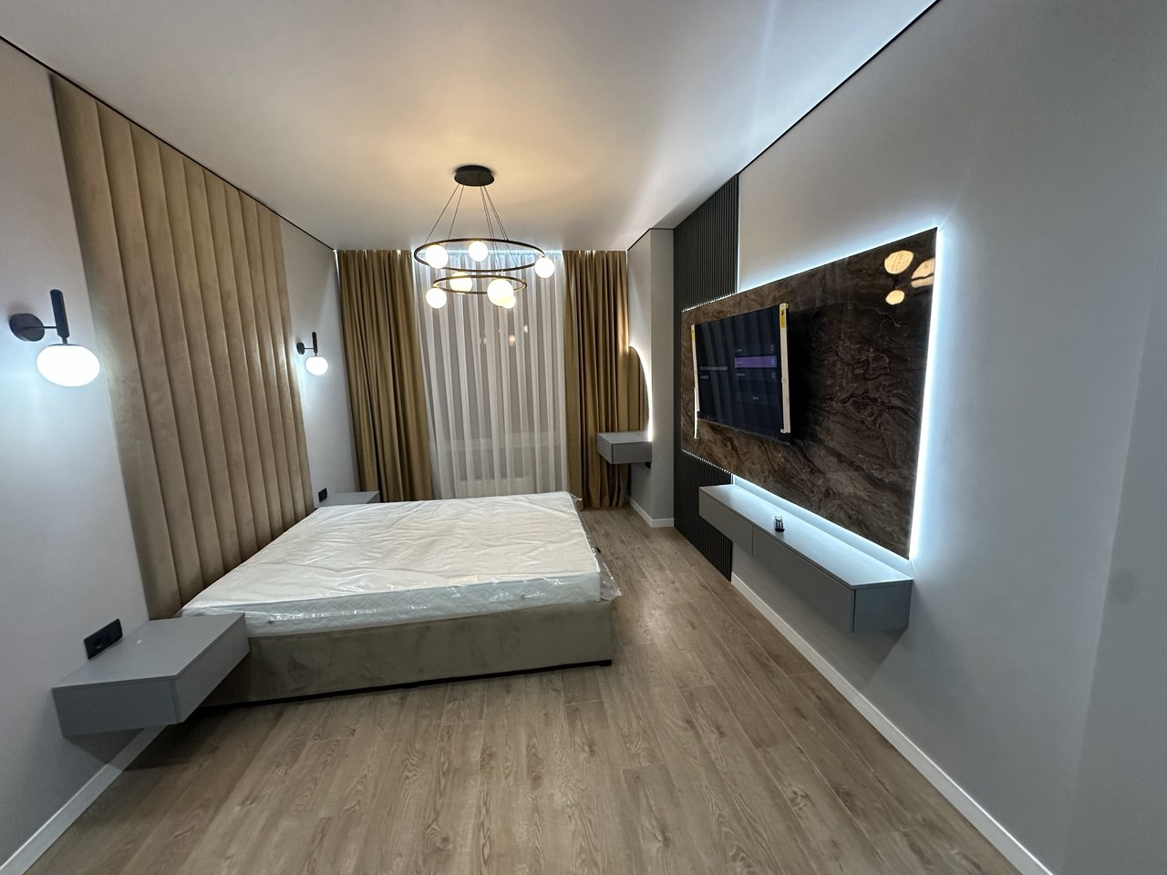
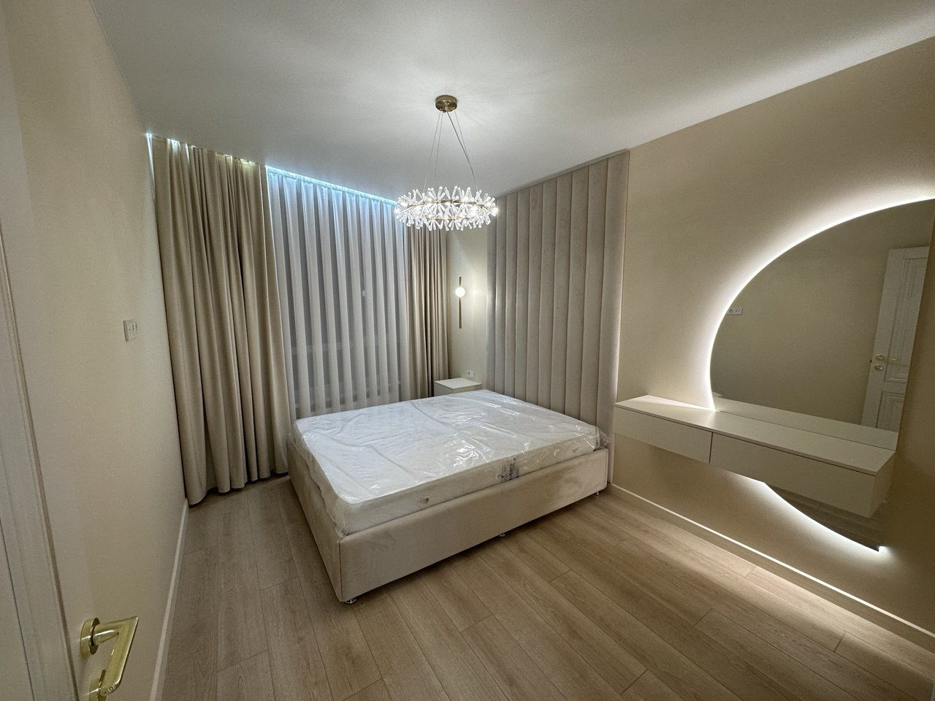
Case Study – 2 SmartInvest.md Projects
📍 Mușatinilor – 2-room apartment, 80 m²
Purchase price: €91,000
Renovation: €38,500
Total investment: €130,000
Sale price: €170,000
Net profit: €30,400
Investor ROI: 28% annualised
Duration: 7 months
📍 Cornești – 2-room apartment, 68 m²
Purchase price: €90,430
Renovation: €26,800
Total investment: €117,230
Sale price: €161,000
Net profit: €33,970
Investor ROI: 41% annualised
Duration: 6 months

Slide 10
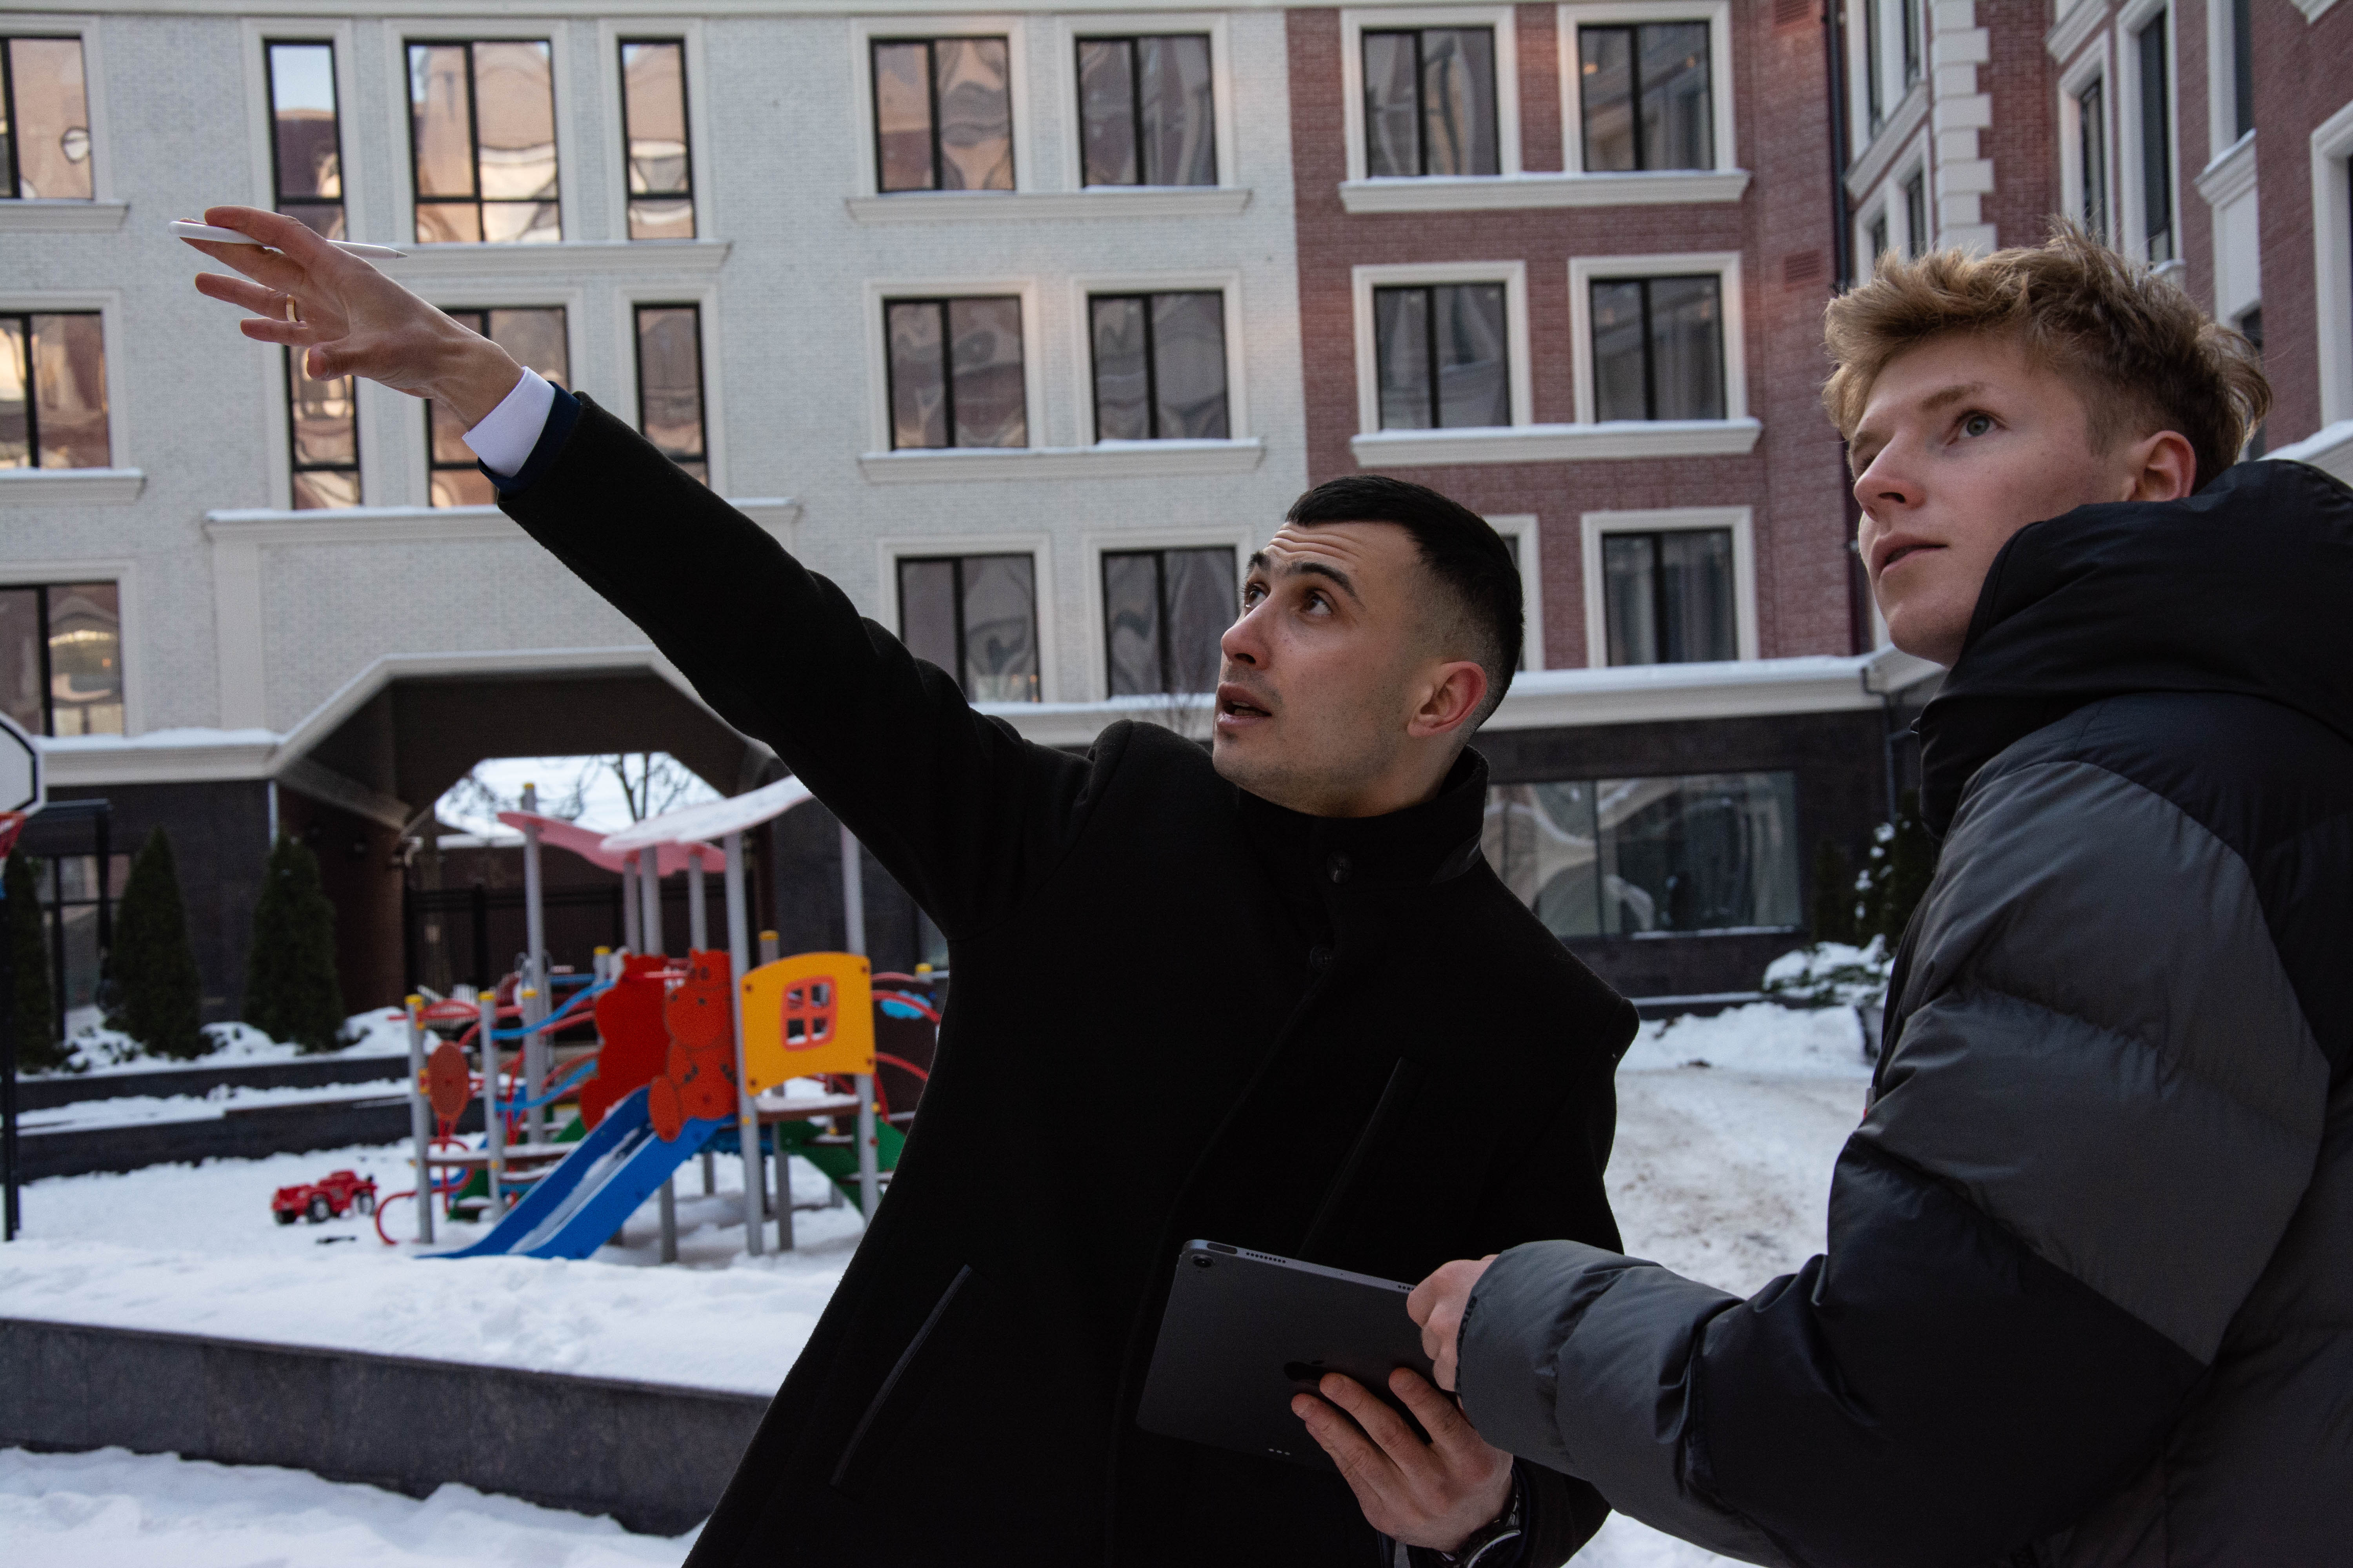
Exclusive Opportunities – Available in Real Time
At SmartInvest.md, we don’t showcase properties that are “pending.”
We provide access.
✔ We work directly with developers, construction companies, and property owners
✔ We secure the best deals before they hit the public market
✔ We deliver only verified and undervalued deals
✔ We act fast – because real opportunities don’t wait
📌 Properties that generate real profit don’t stay on the market for long.
That’s why SmartInvest.md investors get in first.

Slide 11

What a Smart €1,000,000 Portfolio Looks Like with SmartInvest.md
📌 The investment is strategically distributed across 7–8 parallel projects
📌 Project type: 2-room apartments (renovation + sale)
📌 Average investment per project: €130,000
📌 Estimated total profit: €210,000 – €250,000
📌 Average annualised ROI: 25% – 30%
📌 Investment cycle: approx. 7–9 months
📌 Full management provided by SmartInvest.md

Slide 12
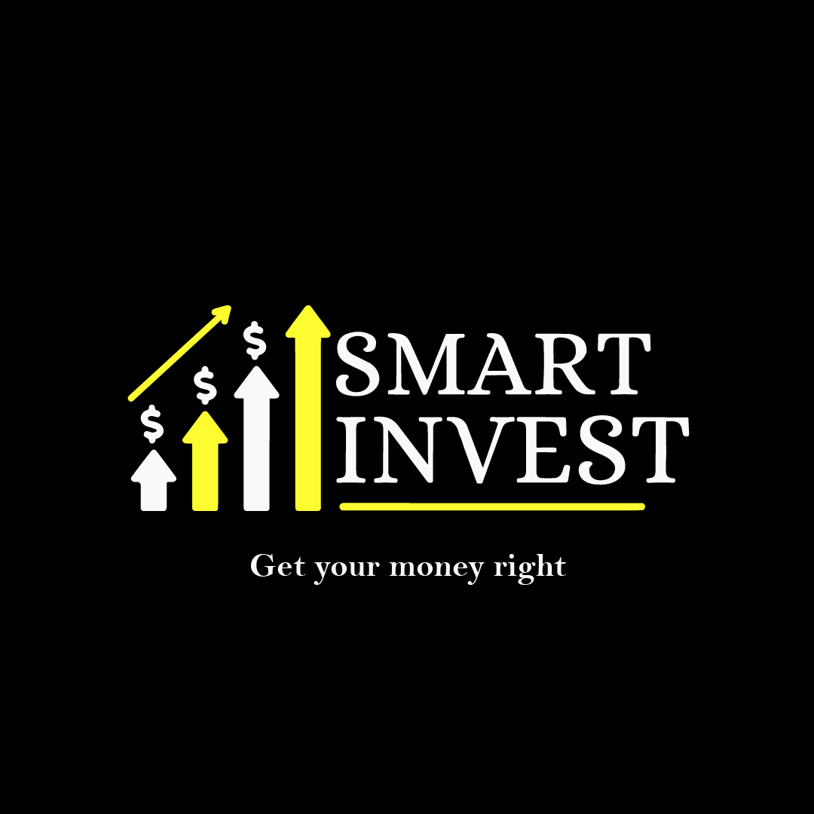
Let’s build the next successful project together
🔍 What we’re looking for:
✔ A strategic partner ready to invest a minimum of €1,000,000
✔ Open to long-term collaboration based on mutual trust
✔ Committed to growing capital through secure and transparent investments
🎯 What we offer:
✔ Access to the best real estate opportunities on the market
✔ A proven business model with 0 failures and 0 unhappy investors
✔ Full investment management
✔ Transparent reporting and profit sharing: 70% investor / 30% SmartInvest.md
📍 Str. Nicolae Zelinschi 7, Floor 5, Office 507
📧 dorin.ilovan@smartinvest.md
📞 +37360093031
🌐 www.smartinvest.md

